Slide 1
Social Media and Web Analytics
Search Engine Marketing

Slide 2
SEM – Paid Search advertising
Purchasing advertising to be displayed with keyword searches
Why SEM?
Control over content
Better measurement
Repeated exposures can also help in brand recognition

Slide 3
Keyword choice
Type of Match | Example | Description | Advantages | Disadvantages
Broad | Car cleaning | All matches are provided that relate car and cleaning | Least time to set up, wide coverage | Poor targeting and may become expensive
Broad Modifier Match | +car +cleaning | Closest match is provided | Same as above but more directed | Same as above
Phrase | Car cleaning at home | Same as broad but words should enter in sequence | Useful if phrase matches product description or use | Higher costs and poorly targeted segments
Exact | “Car cleaning” | Must match exact phrase used | Most relevant searches. Useful if consumer knows what to search for | More input by marketers
Negative | Sales, repair | Stops searches on those terms | More specific targeting | Resource intensive

Slide 4

MINI CASE: Masterkey INDIA
A one stop service for home cleaning requirements
A customer centered approach to providing different cleaning services like sofa, home, kitchen, floor and car cleaning.
Run by a former investment banker, IIM B graduate with a passion for professionalism
Declaration: I have some financial interests in this enterprise

Slide 5
MINI CASE: SEO Strategy @ Masterkey
The journey initially
Online listing on Yellowpages, JustDial, Sulekha etc.
Unscrupulous, multiple leads sold
Organic search (inbound advertising)
Initially taken for a ride by digital marketing agencies.
Meta tags, content generation but no direction provided
Problems with inbound marketing
“How to clean stains”, “How do I wash my car”

Slide 6
MINI CASE: SEO Strategy @ Masterkey
Decided to do SEM on their own. Spent some time listening to content on Youtube and other online sites.
Paid Search – Key insights
Landing page (relevant to ad created, video, - how to keep people on page)
Different landing pages for different ads
Contact / Relevance
Lot of interaction with Google Support Team
Lots of marketing parts combined with experimentation

Slide 7
Google Adwords
Live Demonstration

Slide 8
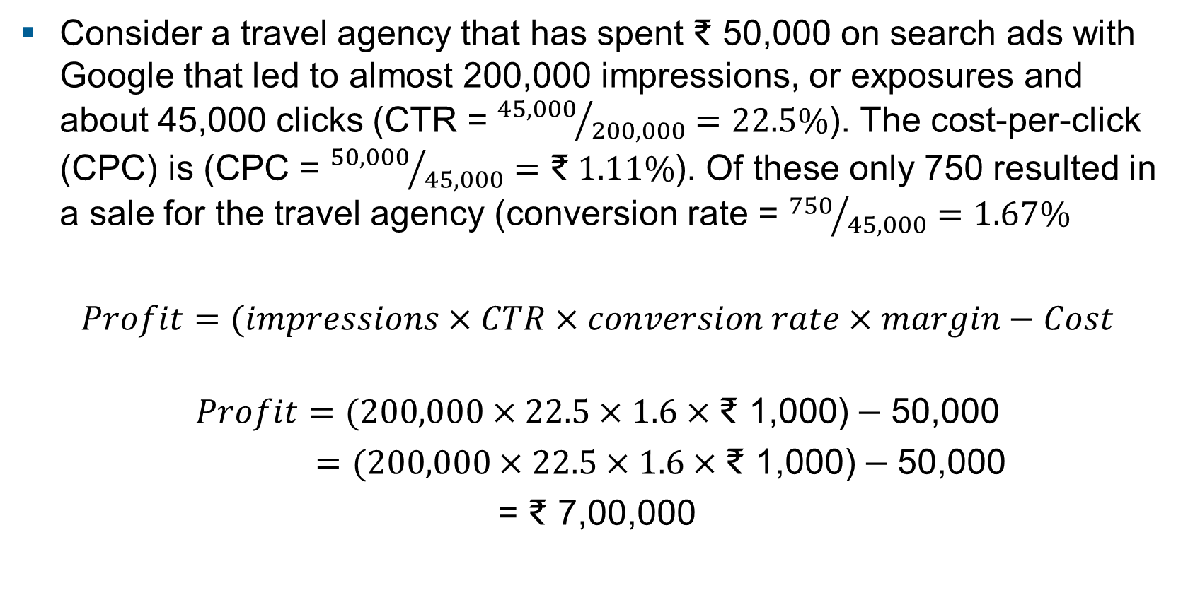
Calculating ROI
Consider a travel agency that has spent ₹ 50,000 on search ads with Google that led to almost 200,000 impressions, or exposures and about 45,000 clicks (CTR = ${45,000}/{200,000}=22.5\%$). The cost-per-click (CPC) is (CPC = ${50,000}/{45,000}=\text{₹} 1.11\%$). Of these only 750 resulted in a sale for the travel agency (conversion rate = ${750}/{45,000}=1.67\%$
$Profit=(impressions×CTR×conversion rate×margin−Cost$
$$Profit=(200,000×22.5×1.6×\text{₹ }\text{1}\text{,000}\text{)}−\text{50,000}$$
$=(200,000×22.5×1.6×\text{₹ 1,000}\text{)}−\text{50,000}$
= ₹ 7,00,000

Slide 9
SEM findings
Customers
Customers acquired through search purchase more and generate higher CLV than customers from other online and offline channels (Chan, Wu and Xie 2011)
Paid search advertising is more effective than offline advertising (Dinner, Van Heerde and Neslin 2014) and email
Performance
Higher position leads to higher CTR (Ghose and Yang 2009) but is asymmetric (Agarwal et al. 2011)
Presence of brand name and location information leads to higher CTR (Rutz, Bucklin and Sonnier 2012)

Slide 10
SEM findings
Interdependence
Positive interdependence between organic and search ads (Yang and Ghose 2010)
Spillover effects of generic keywords to branded keywords (Rutz and Bucklin 2011)
Impact of Television advertising on keyword search (Joo, Wilbur, Zhu 2016). No impact on category search but on branded search

Slide 11
Generalized Second price auctions
“[Google’s] unique auction model uses Nobel Prizewinning economic theory to eliminate [. . . ] that feeling that you’ve paid too much.”
— marketing materials at google.com

Slide 12
Key Idea
Google’s (2002) generalized second price auction (GSP)
Pay the bid of the next highest bidder
Adopted by Yahoo!/ ebay etc.
Example: Two slots, three bidders. First slot gets 1000 clicks per hour, second slot gets 800. Bidders 1,2 and 3 have values per click of ₹20, ₹10 and ₹5 respectively.
Under GSP, the different payments for the slots will be ₹10 and ₹5 per click. Total payments of bidders one and two are ₹10,000 and ₹4000

Slide 13
Strategy
Truth-telling is not a dominant strategy under GSP.
Value per click - ₹20, ₹10 and ₹5 ; CTR – 1000 & 800
Truth telling payoffs:
Bidder 1’s payoff – (₹20 - ₹10) x 1000 = ₹10,000
If instead bidder 1 bids ₹6
Bidder 1’s payoff – (₹20 - ₹6) x 800 = ₹11,200
₹11,200 > ₹10,000

